Slide 1
Writing our first program
  Integrated Development Environments are used for writing programs.
  In the past, programs were written in text files and compiled via the command line.
  Let’s take a look at how this works….

Slide 2
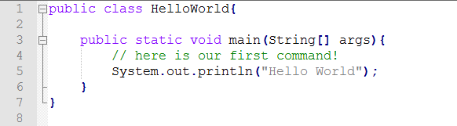
Writing our first program
Open up a text editor, such as Notepad++.
Write the following code in the editor…

Slide 3
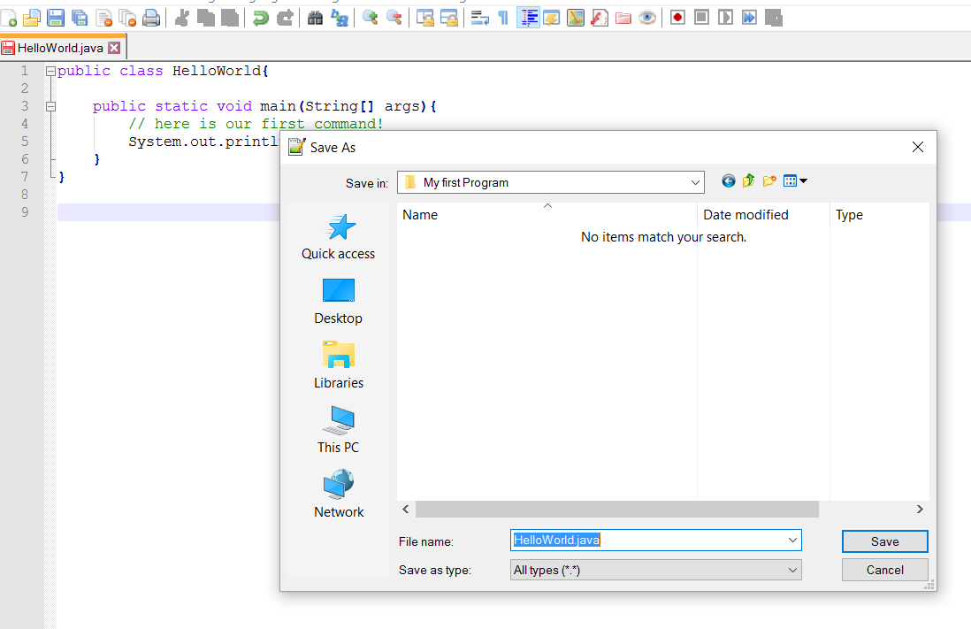
Writing our first program
Once you have checked the syntax and are happy with the layout, save your files as a .java file.

Slide 4
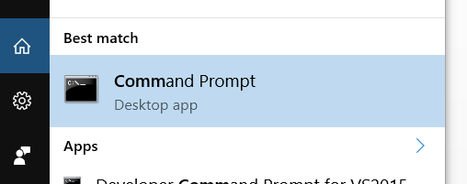
Compiling our first program
Open up a command prompt….
You can search for this via the start menu

Slide 5
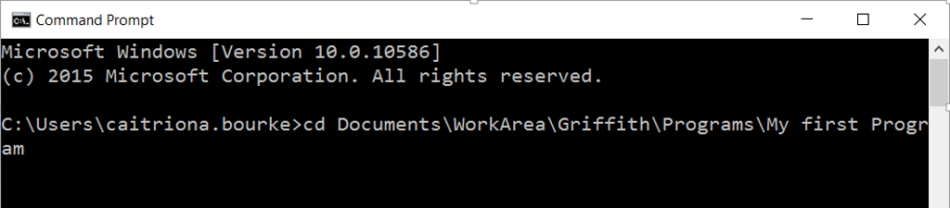
Compiling our first program
Use the cd command to navigate to the folder in which you saved your java file…

Slide 6
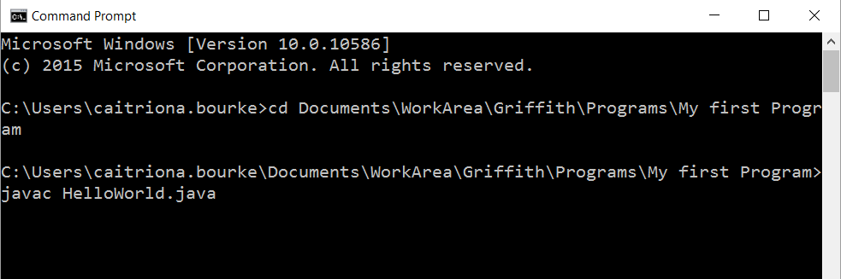
Compiling our first program
Use the javac command to compile your program…

Slide 7
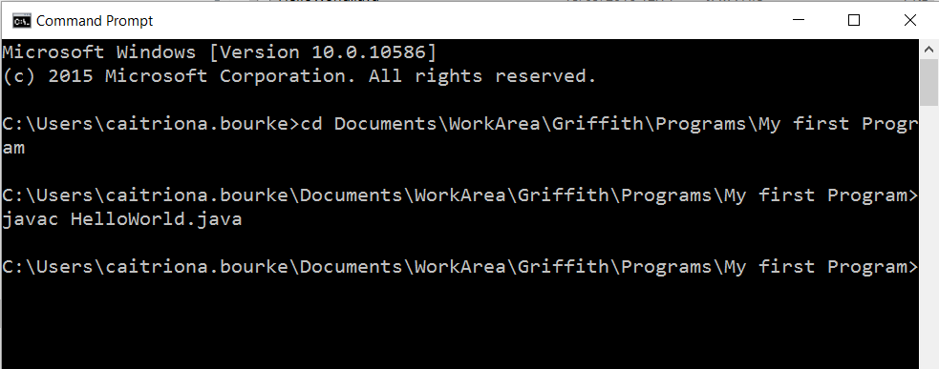
Compiling our first program
If you get no errors, your program should have compiled correctly…

Slide 8
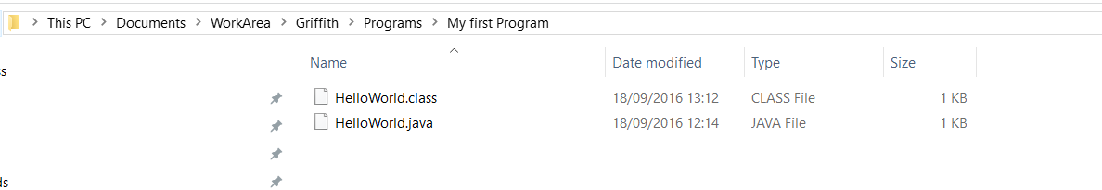
Compiling our first program
When the program has compiled, you should see a new .class file in the same folder as your .java file.

Slide 9
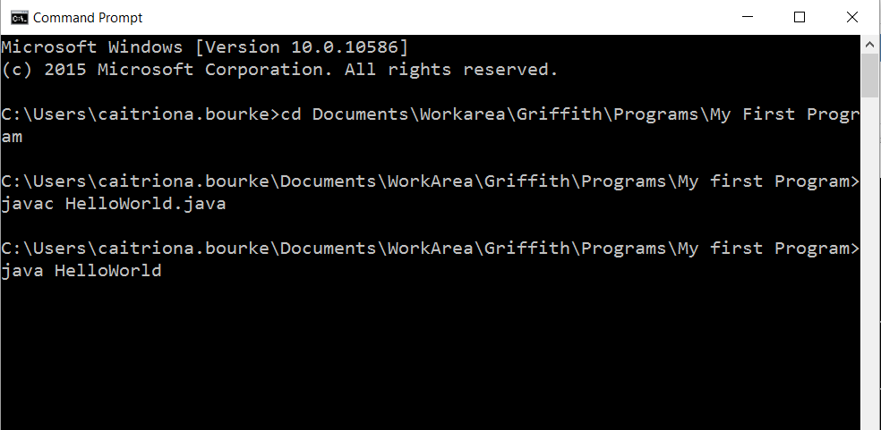
Running our first program
You can now run your program, using the java command.

Slide 10
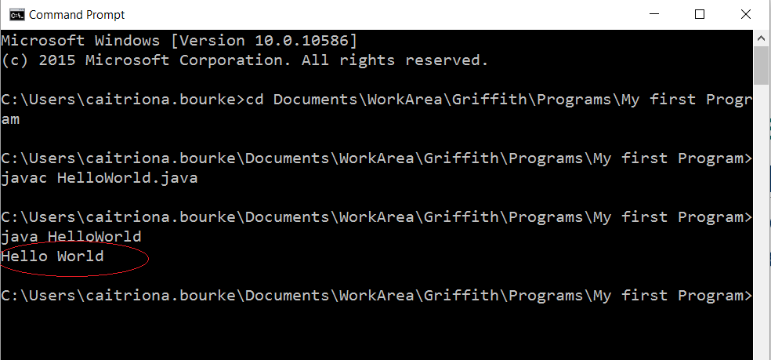
Running your program
Your command to print “Hello World” will have printed the text to the screen!

